Slide 1
Automated In-Plant Line Inspection Reporting System
Jufrey Niño E. Bayog
John Paul S. Bobila
Systems Development
PIMD-ICT

Slide 2
Presentation Outline
AIPLIRS Core Updates by screenshot

Slide 3
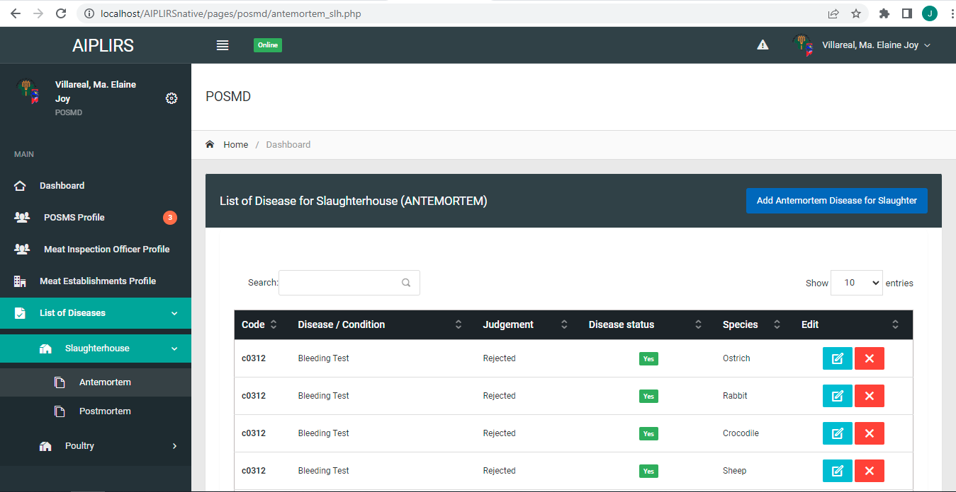
Duplicated Diseases & Condition

Slide 4
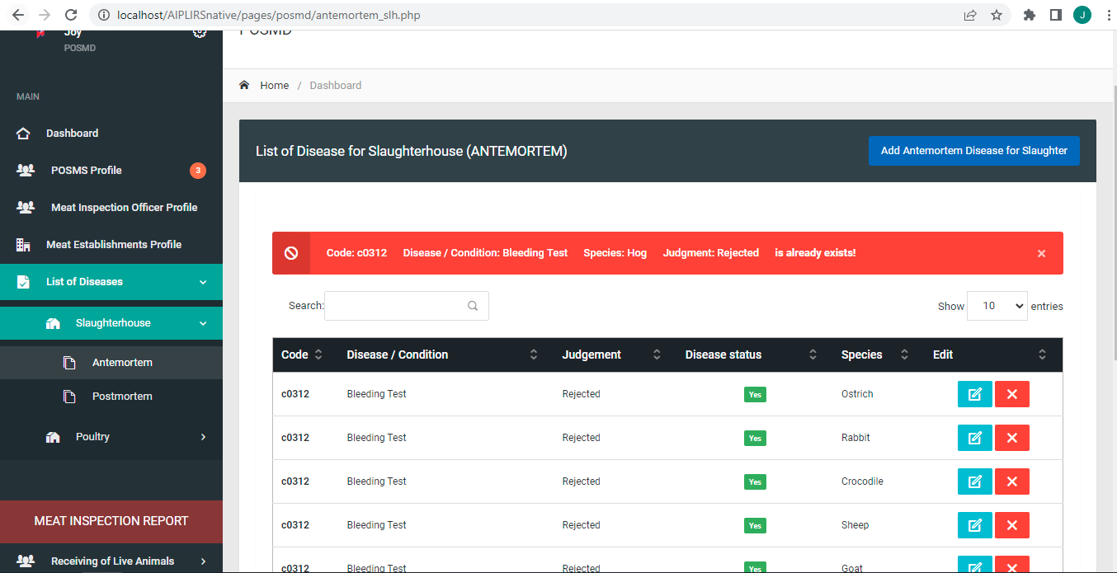
Duplicated Diseases & Condition Comparison

Slide 5
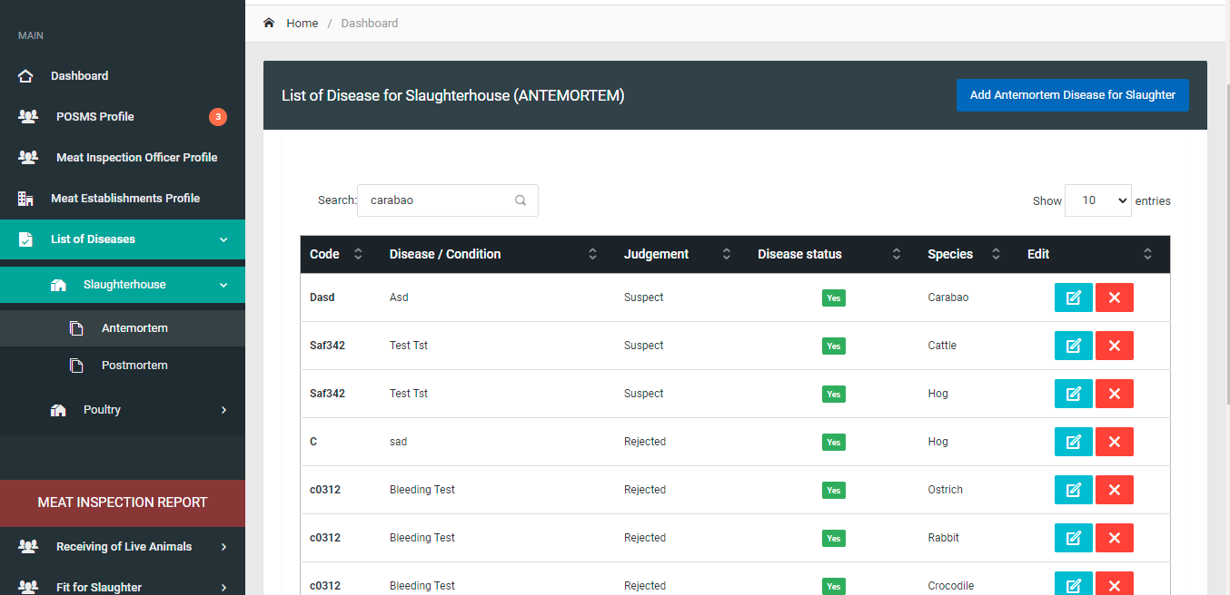
Filtering of Diseases not responsive

Slide 6
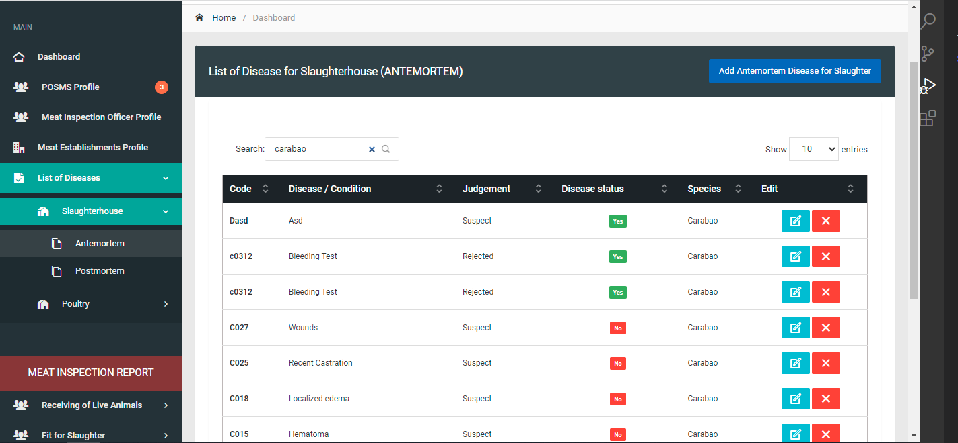
Filtering of Diseases not responsive comparison

Slide 7
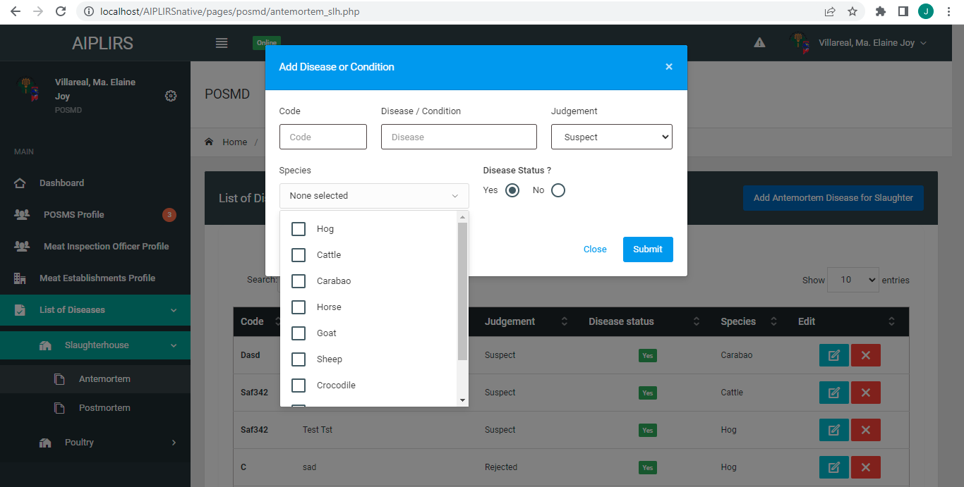
Species must have select / deselect all function in multi select

Slide 8
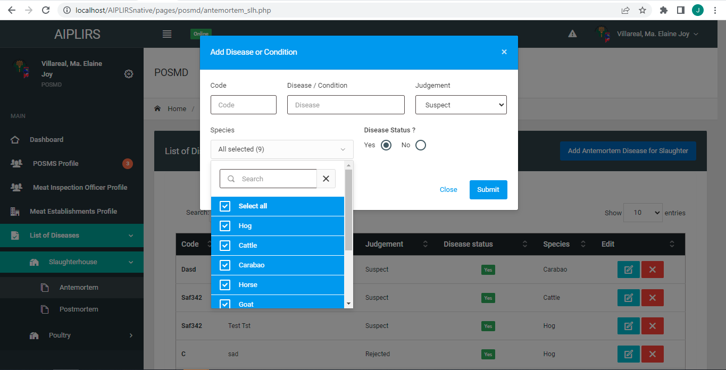
Species must have select / deselect all function in multi select comparison

Slide 9
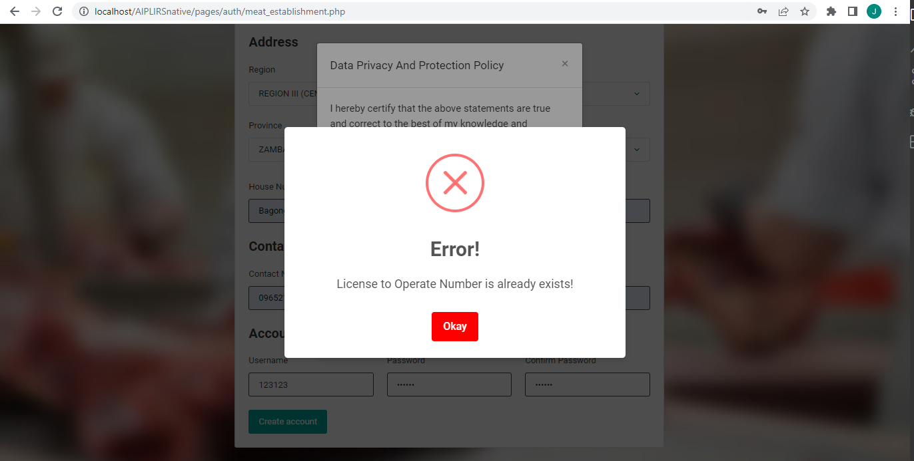
Validation for the existing LTO number upon registration of ME

Slide 10
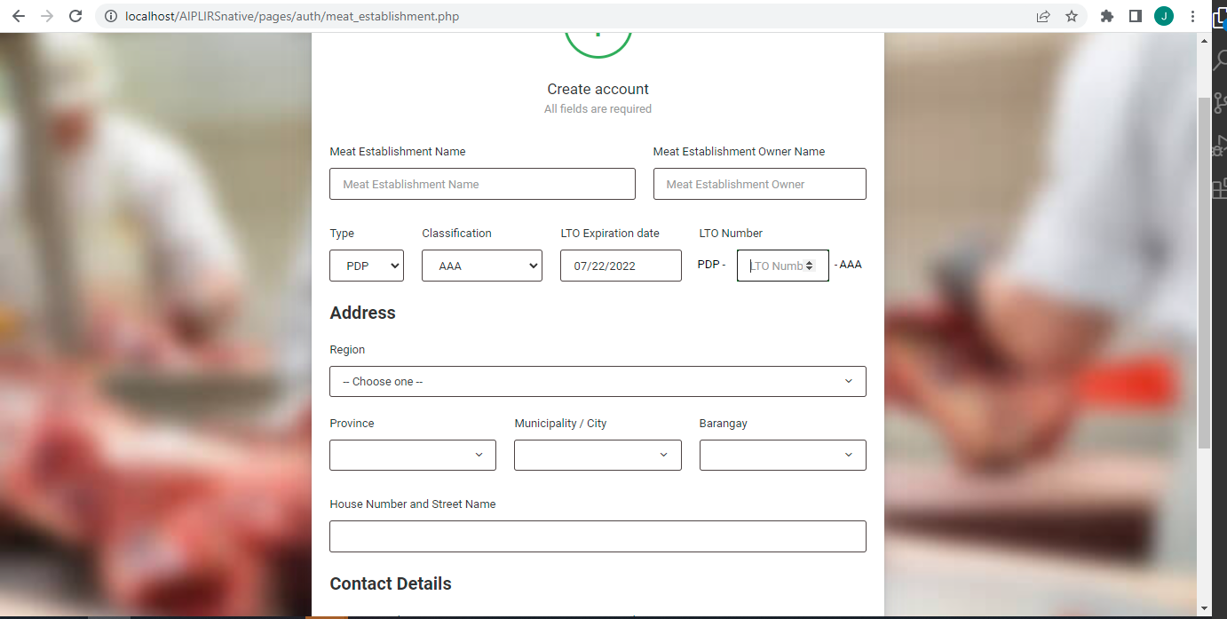
LTO Number formatting

Slide 11
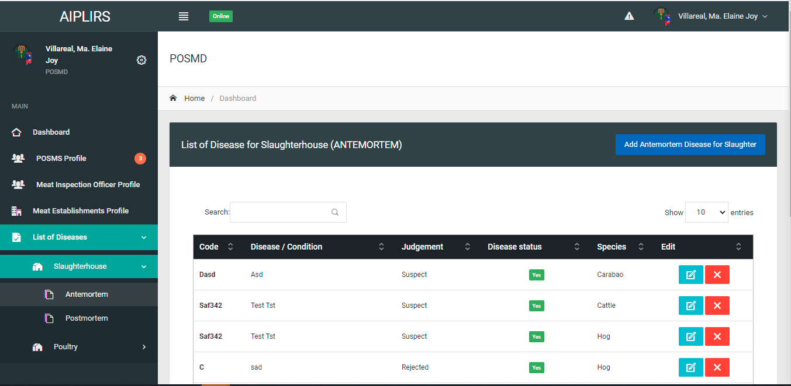
Button label

Slide 12
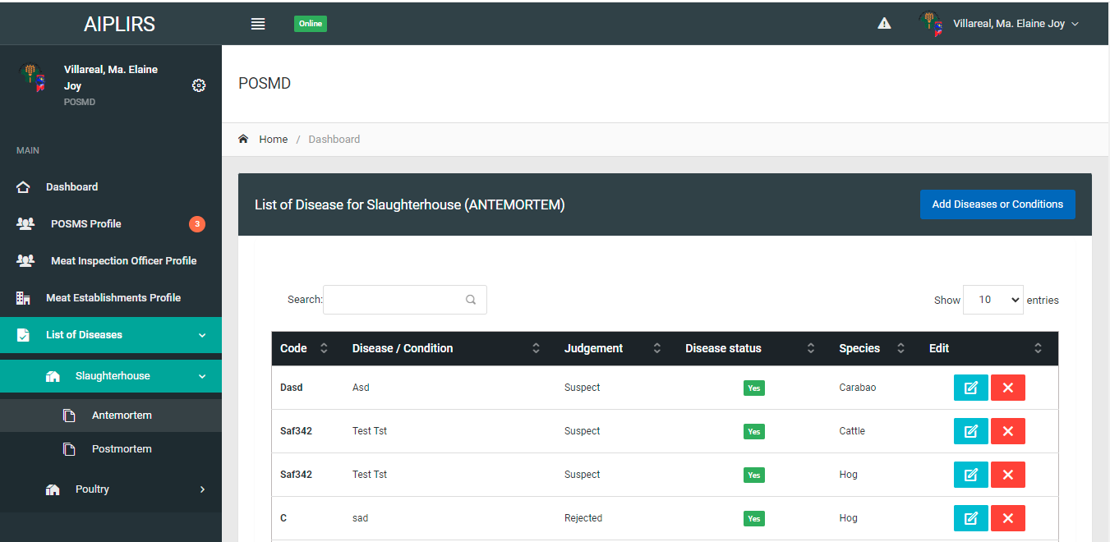
Button label comparison

Slide 13
Sidebar menu label

Slide 14
Sidebar menu label

Slide 15

Sidebar menu label

Slide 16
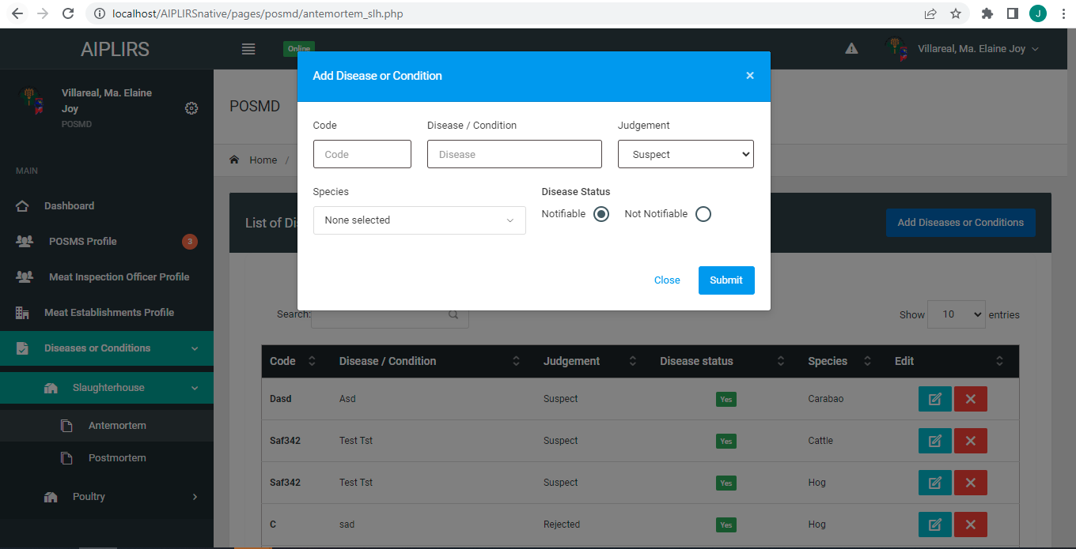
Remove question mark disease status and change the option yes or no to Notifiable / Not Notifiable

Slide 17
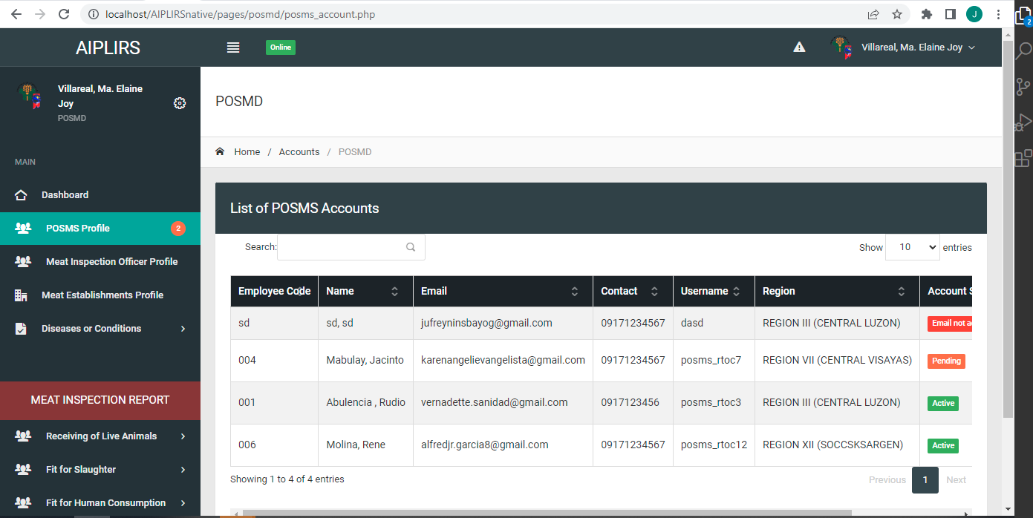
POSMS account change header title

Slide 18
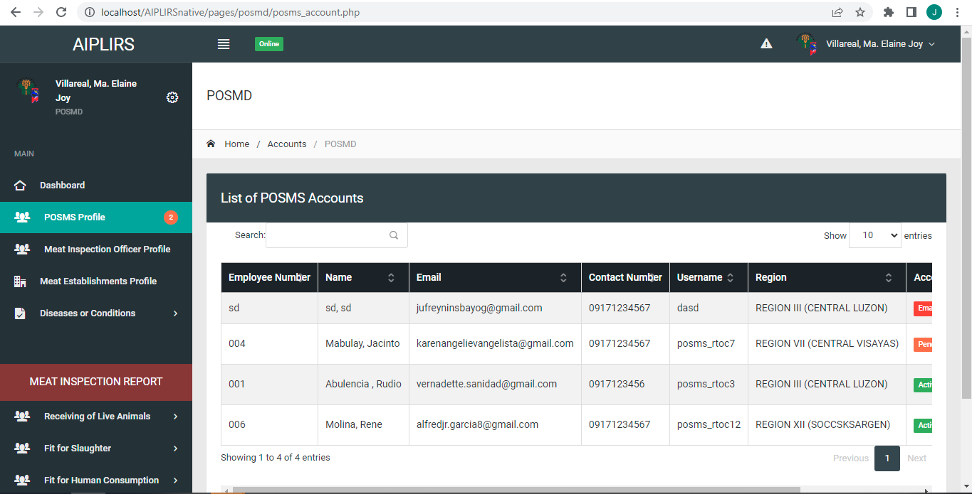
POSMS account change header title comparison

Slide 19
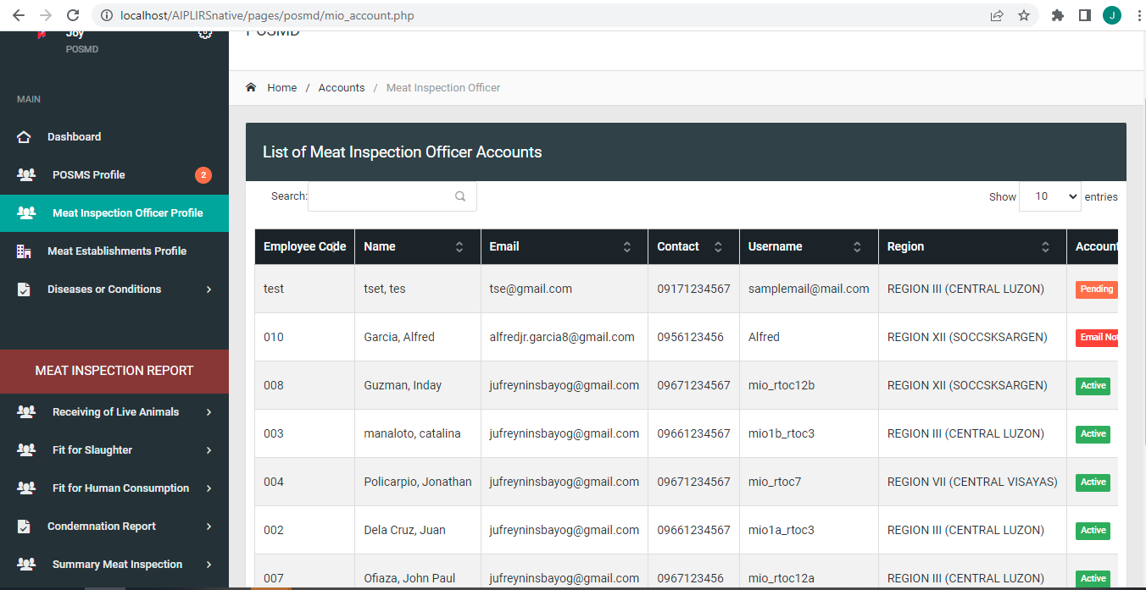
MIO account change header title

Slide 20

MIO account change header title comparison

Slide 21
Change “list of posms accounts” to posms accounts Sidebar: Change “Profile” to”Accounts” “Accounts”

Slide 22
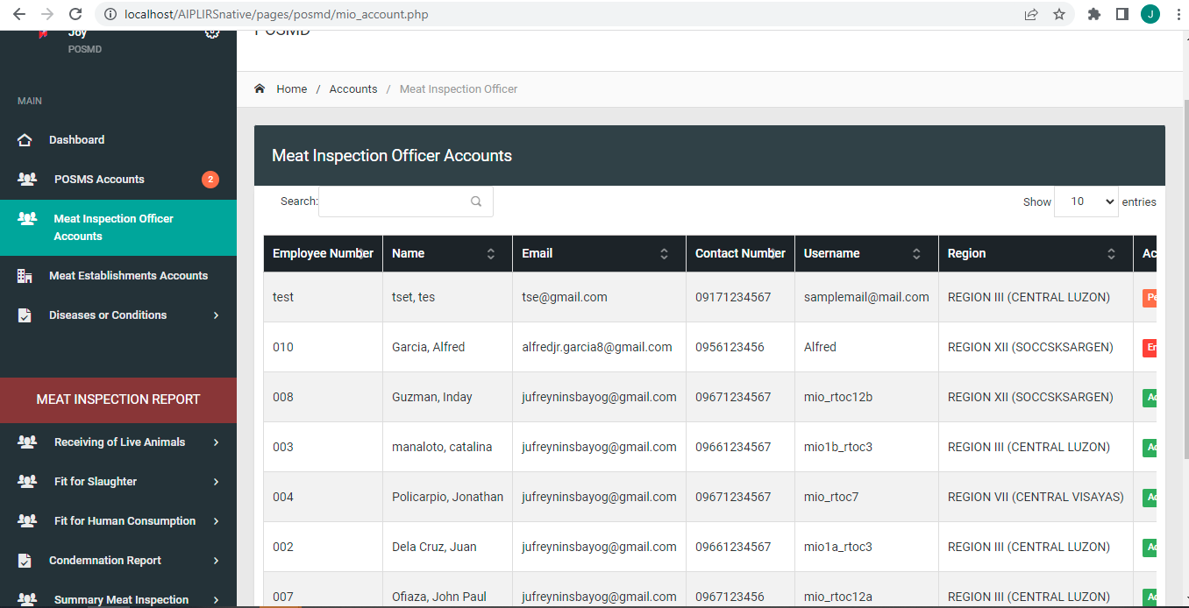
Change “list of posms accounts” to posms accounts Sidebar: Change “Profile” to”Accounts” “Accounts”

Slide 23
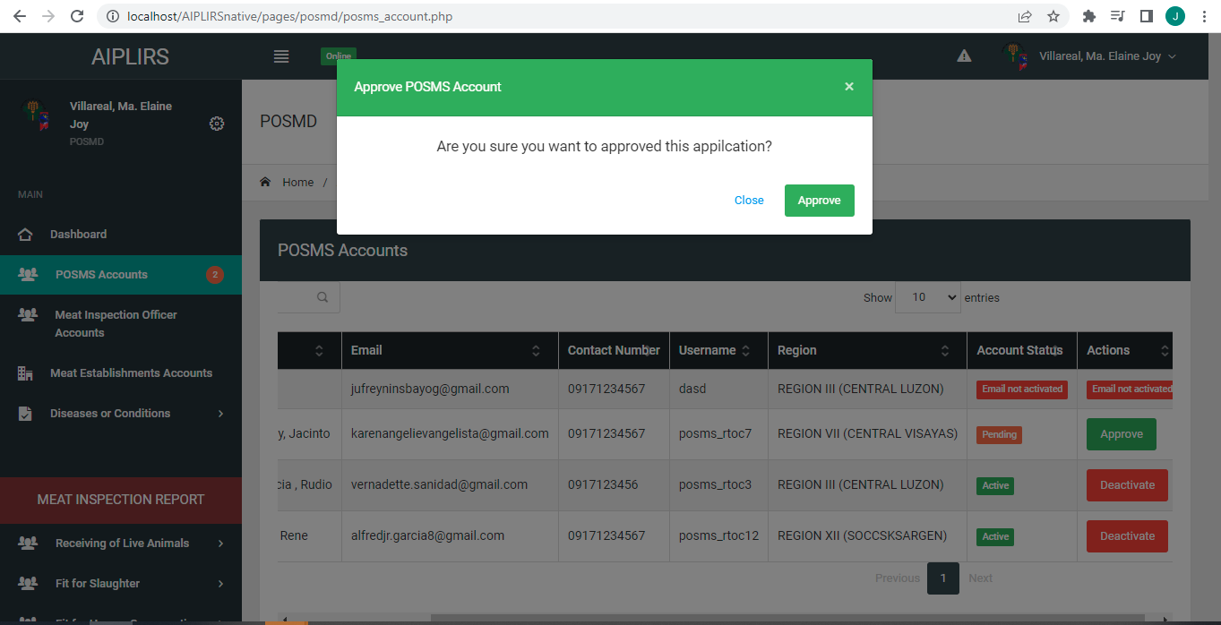
Remove “d” from the word approved remove modal header

Slide 24
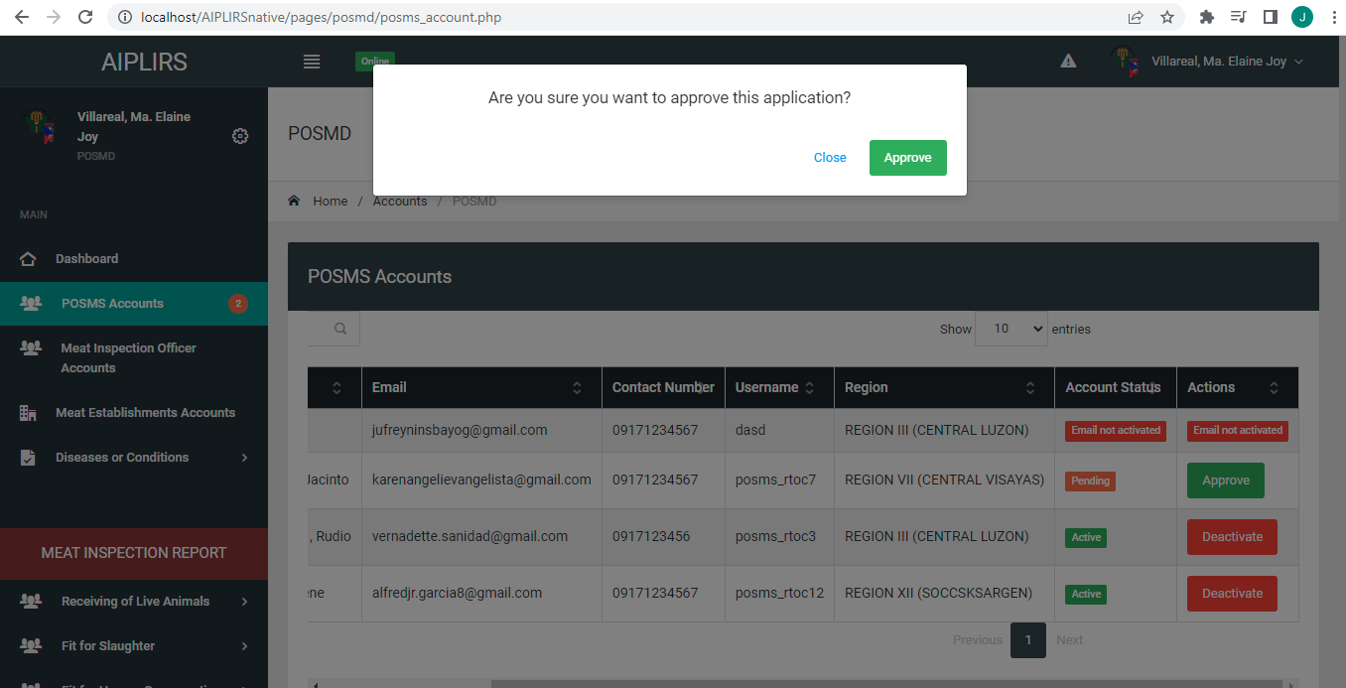
Remove “d” from the word approved remove modal header

Slide 25
Remove “d” from the word approved remove modal header

Slide 26
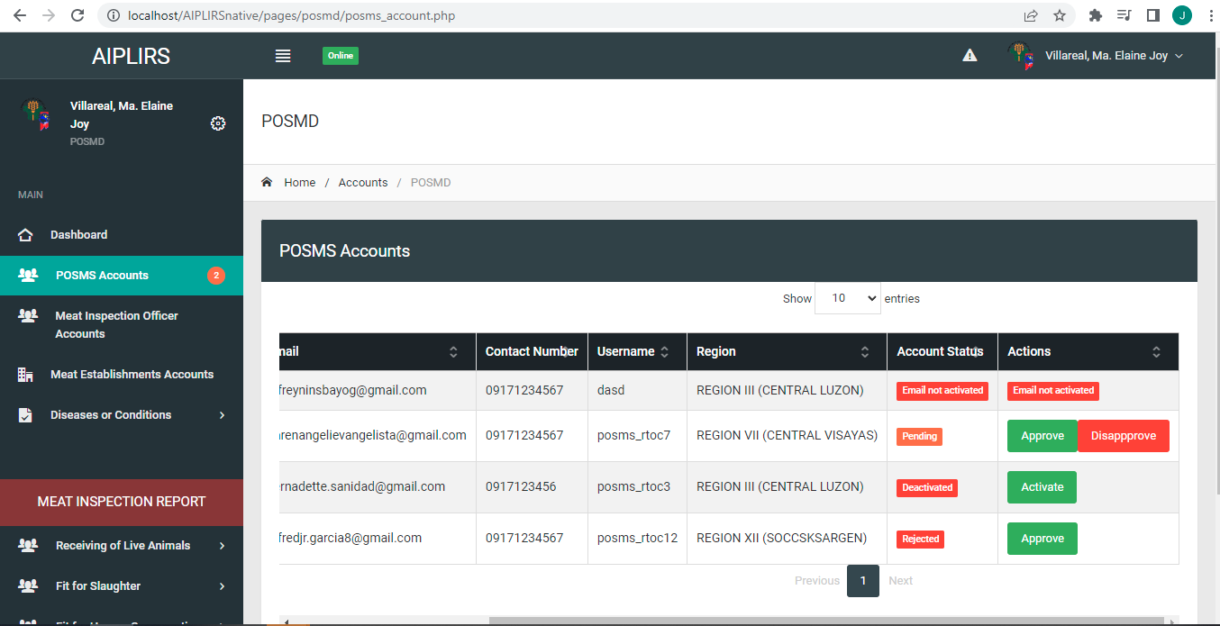
Account status “Pending, Rejected, Active, Deactivated” Actions: “Approve, Disapprove, Deactivate, Activate,” To be included on USER’S MANUAL define each.

Slide 27
1st column : Total Number of Animals Received 2nd Column: Total Number of Animals Slaughtered 3rd Column: Total Volume of Meat Fit For Human Consumption Fit for Human consumption specify What kind of meat additional column after head count Species | head count |Meat type | Weight : Column order

Slide 28
